Slide 1
Probability and Statistics MTH-302
DR. PANKAJ PANDEY
ASSISTANT PROFESSOER (MATHEMATICS)
LOVELY PROFESSIONAL UNIVERSITY, PUNJAB

Slide 2
Random Experiment: If in each trial of experiment conducted under identical conditions, the outcome is not unique, but may be any one of the possible outcomes, then such an experiment is called random experiment.
Outcome: The result of random experiment is called an outcome.
Trial and Event: Any particular performance of a random experiment is called trial and collection of outcome is called an event.
Example: In a throw of dice only six possible results are possible {1, 2, 3, 4, 5, 6}. These are called outcomes. If the outcomes are considered only for even numbers {2, 4, 6} or To obtain number either greater than 4 or odd number.
Mutually Exclusive Events: Two events are called mutually exclusive if both events not happen simultaneously in a same trial.

Slide 3
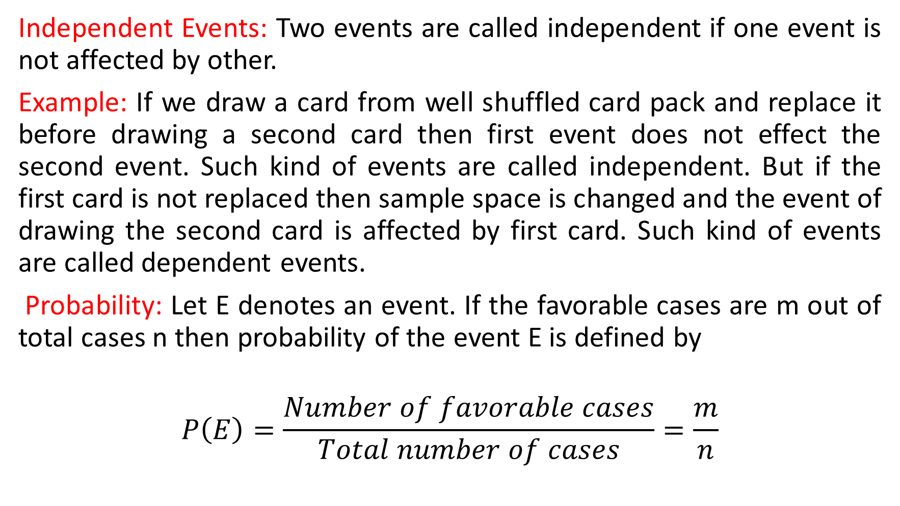
Independent Events: Two events are called independent if one event is not affected by other.
Example: If we draw a card from well shuffled card pack and replace it before drawing a second card then first event does not effect the second event. Such kind of events are called independent. But if the first card is not replaced then sample space is changed and the event of drawing the second card is affected by first card. Such kind of events are called dependent events.
Probability: Let E denotes an event. If the favorable cases are m out of total cases n then probability of the event E is defined by
$$P\left(E\right)=\frac{Number of favorable cases}{Total number of cases}=\frac{m}{n}$$

Slide 4
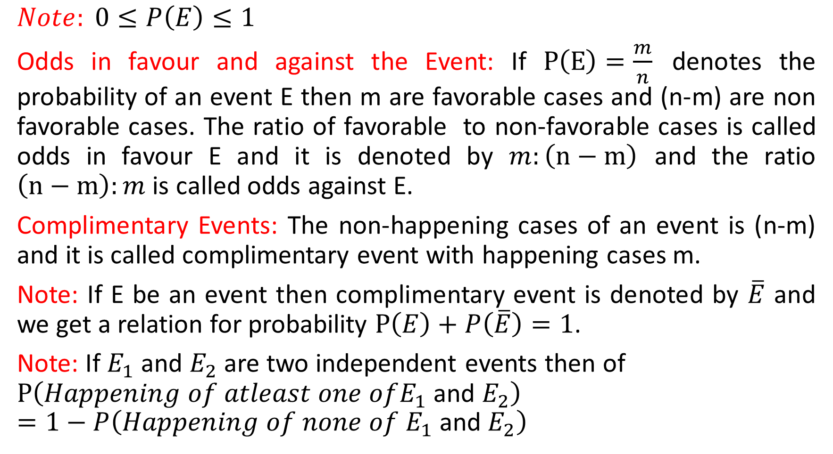
$$Note: 0≤P\left(E\right)≤1$$
Odds in favour and against the Event: If $P\left(E\right)=\frac{m}{n}$ denotes the probability of an event E then m are favorable cases and (n-m) are non favorable cases. The ratio of favorable to non-favorable cases is called odds in favour E and it is denoted by $m:\left(n−m\right)$ and the ratio $\left(n−m\right):m$ is called odds against E.
Complimentary Events: The non-happening cases of an event is (n-m) and it is called complimentary event with happening cases m.
Note: If E be an event then complimentary event is denoted by $\overline{E}$ and we get a relation for probability $P\left(E\right)+P\left(\overline{E}\right)=1$.
Note: If $E_{1}$ and $E_{2}$ are two independent events then of
$$P\left(Happening of atleast one ofE_{1} \text{and} E_{2}\right)=1−P\left(Happening of none of E_{1} \text{and} E_{2}\right)$$

Slide 5

$Note:$ If $P\left(E\right)=1$ then event is called certain event and if $P\left(E\right)=0$ then event is called impossible event.
$Note:$ If out of N trials an event E happens M times (M and N are large) then probability of the event is defined by $P\left(E\right)=\lim_{N→∞}{\frac{M}{N}}$.

Slide 6
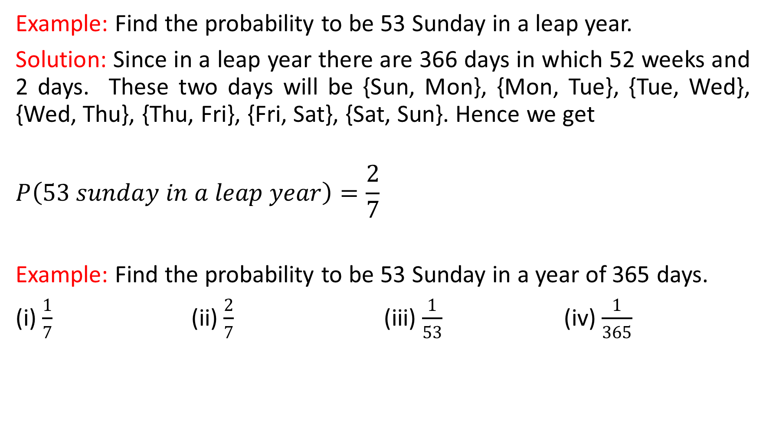
Example: Find the probability to be 53 Sunday in a leap year.
Solution: Since in a leap year there are 366 days in which 52 weeks and 2 days. These two days will be {Sun, Mon}, {Mon, Tue}, {Tue, Wed}, {Wed, Thu}, {Thu, Fri}, {Fri, Sat}, {Sat, Sun}. Hence we get
$$P\left(53 sunday in a leap year\right)=\frac{2}{7}$$
Example: Find the probability to be 53 Sunday in a year of 365 days.
(i) $\frac{1}{7}$ (ii) $\frac{2}{7}$ (iii) $\frac{1}{53}$ (iv) $\frac{1}{365}$

Slide 7
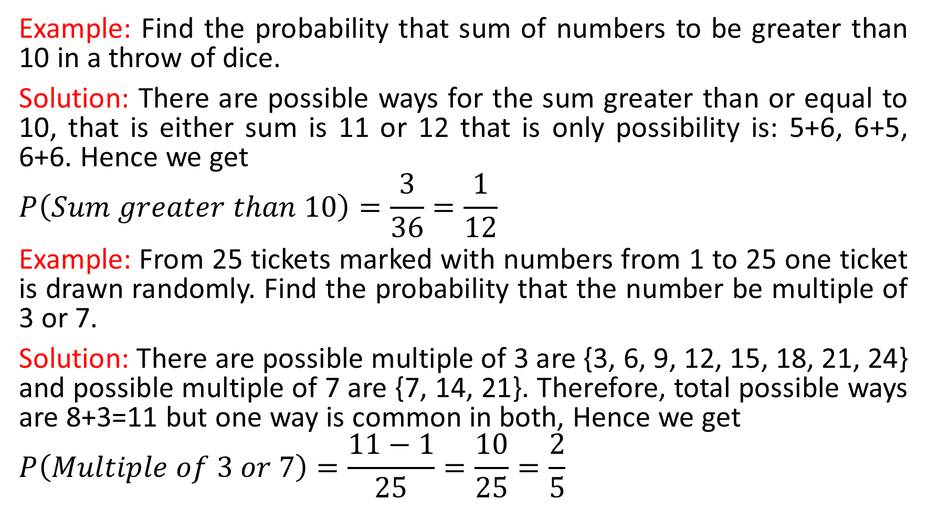
Example: Find the probability that sum of numbers to be greater than 10 in a throw of dice.
Solution: There are possible ways for the sum greater than or equal to 10, that is either sum is 11 or 12 that is only possibility is: 5+6, 6+5, 6+6. Hence we get
$$P\left(Sum greater than 10\right)=\frac{3}{36}=\frac{1}{12}$$
Example: From 25 tickets marked with numbers from 1 to 25 one ticket is drawn randomly. Find the probability that the number be multiple of 3 or 7.
Solution: There are possible multiple of 3 are {3, 6, 9, 12, 15, 18, 21, 24} and possible multiple of 7 are {7, 14, 21}. Therefore, total possible ways are 8+3=11 but one way is common in both, Hence we get
$$P\left(Multiple of 3 or 7\right)=\frac{11−1}{25}=\frac{10}{25}=\frac{2}{5}$$

Slide 8
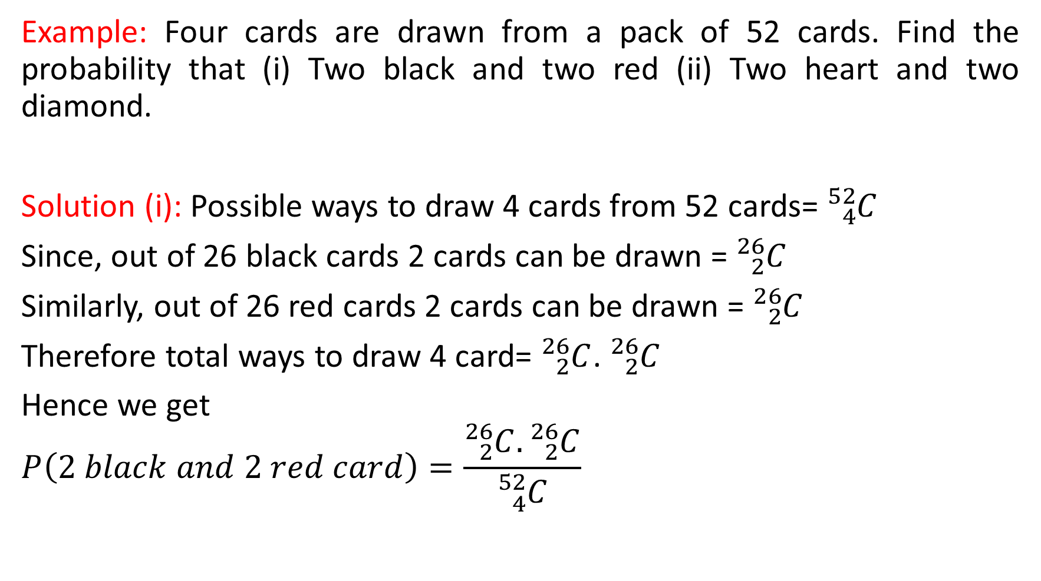
Example: Four cards are drawn from a pack of 52 cards. Find the probability that (i) Two black and two red (ii) Two heart and two diamond.
Solution (i): Possible ways to draw 4 cards from 52 cards= ${}_{4}^{52}C$
Since, out of 26 black cards 2 cards can be drawn = ${}_{2}^{26}C$
Similarly, out of 26 red cards 2 cards can be drawn = ${}_{2}^{26}C$
Therefore total ways to draw 4 card= ${}_{2}^{26}C$. ${}_{2}^{26}C$
Hence we get
$$P\left(2 black and 2 red card\right)=\frac{{}_{2}^{26}C.{}_{2}^{26}C}{{}_{4}^{52}C}$$

Slide 9
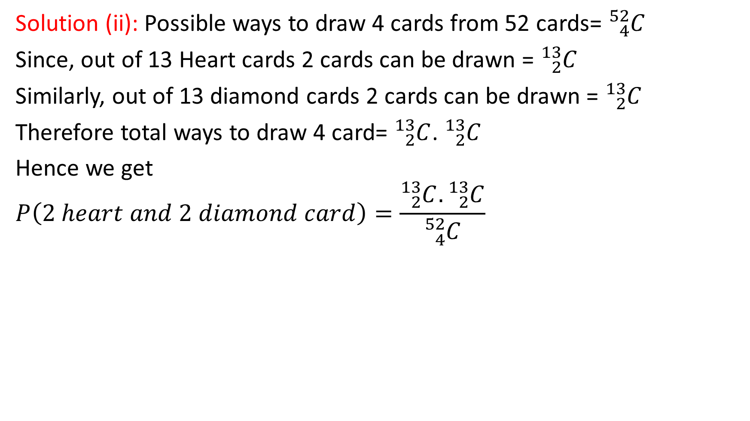
Solution (ii): Possible ways to draw 4 cards from 52 cards= ${}_{4}^{52}C$
Since, out of 13 Heart cards 2 cards can be drawn = ${}_{2}^{13}C$
Similarly, out of 13 diamond cards 2 cards can be drawn = ${}_{2}^{13}C$
Therefore total ways to draw 4 card= ${}_{2}^{13}C$. ${}_{2}^{13}C$
Hence we get
$$P\left(2 heart and 2 diamond card\right)=\frac{{}_{2}^{13}C.{}_{2}^{13}C}{{}_{4}^{52}C}$$

Slide 10
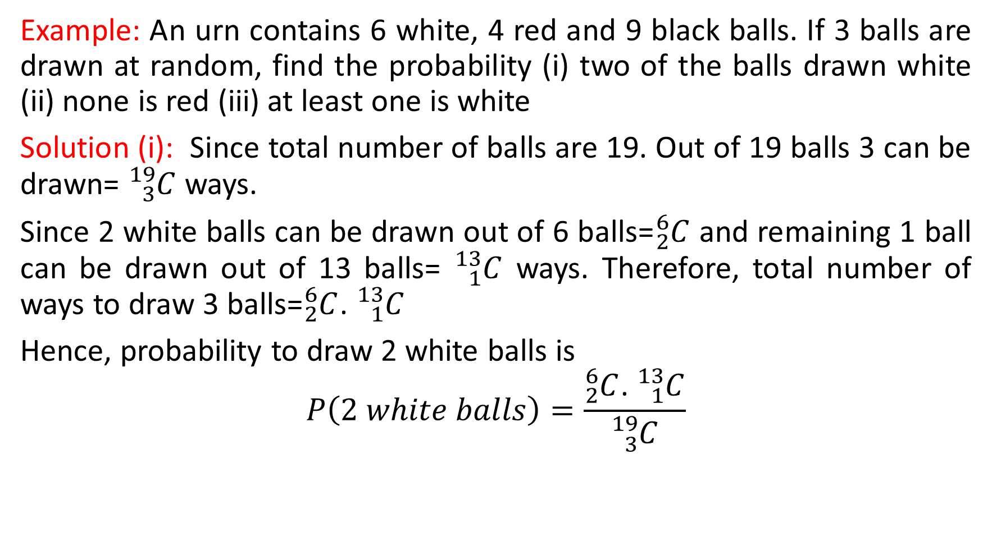
Example: An urn contains 6 white, 4 red and 9 black balls. If 3 balls are drawn at random, find the probability (i) two of the balls drawn white (ii) none is red (iii) at least one is white
Solution (i): Since total number of balls are 19. Out of 19 balls 3 can be drawn= ${}_{3}^{19}C$ ways.
Since 2 white balls can be drawn out of 6 balls=${}_{2}^{6}C$ and remaining 1 ball can be drawn out of 13 balls= ${}_{1}^{13}C$ ways. Therefore, total number of ways to draw 3 balls=${}_{2}^{6}C$. ${}_{1}^{13}C$
Hence, probability to draw 2 white balls is
$$P\left(2 white balls\right)=\frac{{}_{2}^{6}C\text{.} {}_{1}^{13}C}{{}_{3}^{19}C}$$

Slide 11
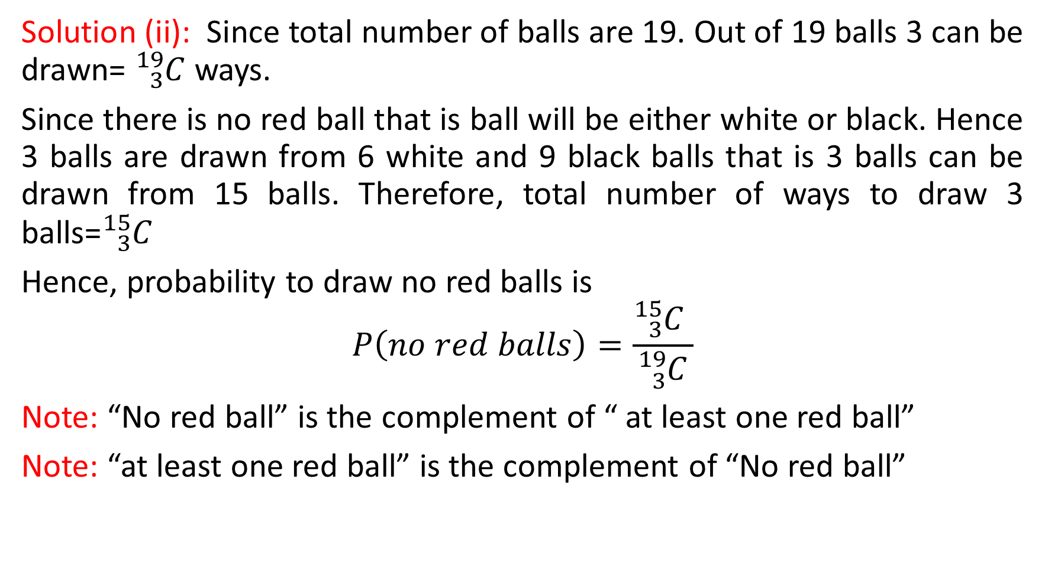
Solution (ii): Since total number of balls are 19. Out of 19 balls 3 can be drawn= ${}_{3}^{19}C$ ways.
Since there is no red ball that is ball will be either white or black. Hence 3 balls are drawn from 6 white and 9 black balls that is 3 balls can be drawn from 15 balls. Therefore, total number of ways to draw 3 balls=${}_{3}^{15}C$
Hence, probability to draw no red balls is
$$P\left(no red balls\right)=\frac{{}_{3}^{15}C }{{}_{3}^{19}C}$$
Note: “No red ball” is the complement of “ at least one red ball”
Note: “at least one red ball” is the complement of “No red ball”

Slide 12

Solution (iii): Since total number of balls are 19. Out of 19 balls 3 can be drawn= ${}_{3}^{19}C$ ways.
Since at least one ball is white which is compliment of no ball is white.
Hence, the probability to draw at least one white balls is
$$P\left(\text{at} \text{least} \text{one} \text{white} \text{ball}\right)=1−\frac{{}_{3}^{13}C }{{}_{3}^{19}C}$$

Slide 13
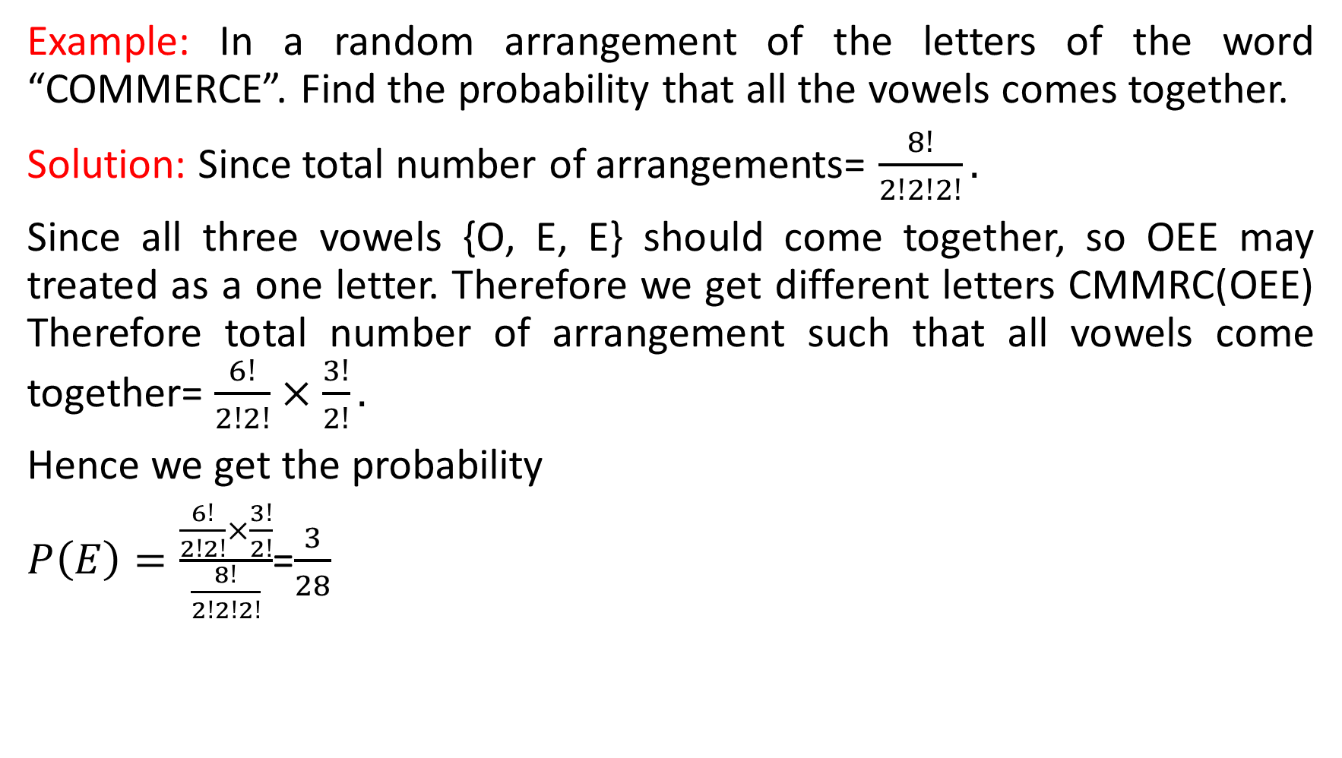
Example: In a random arrangement of the letters of the word “COMMERCE”. Find the probability that all the vowels comes together.
Solution: Since total number of arrangements= $\frac{8!}{2!2!2!}.$
Since all three vowels {O, E, E} should come together, so OEE may treated as a one letter. Therefore we get different letters CMMRC(OEE) Therefore total number of arrangement such that all vowels come together= $\frac{6!}{2!2!}×\frac{3!}{2!}.$
Hence we get the probability
$P\left(E\right)=\frac{\frac{6!}{2!2!}×\frac{3!}{2!}}{\frac{8!}{2!2!2!}}$=$\frac{3}{28}$

Slide 14
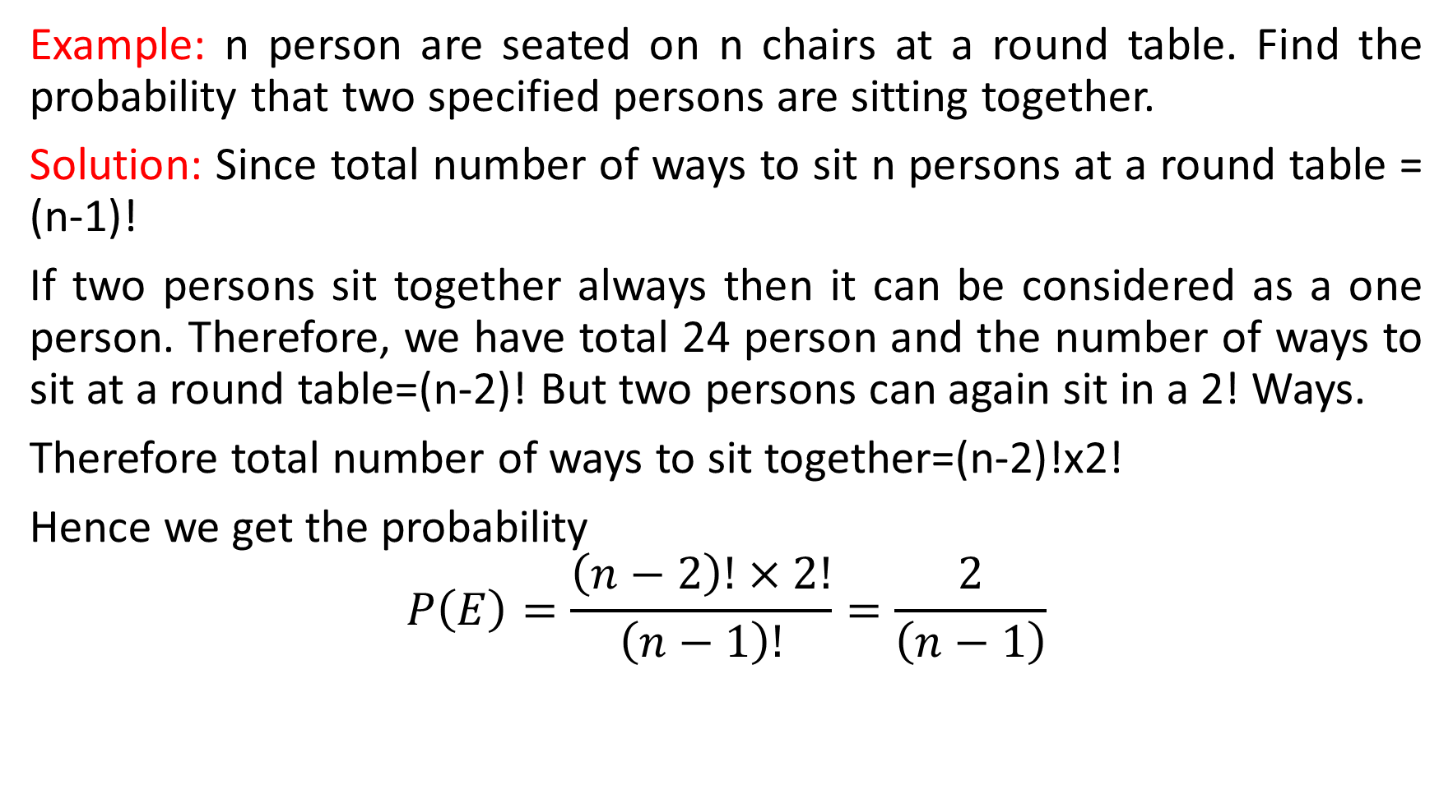
Example: n person are seated on n chairs at a round table. Find the probability that two specified persons are sitting together.
Solution: Since total number of ways to sit n persons at a round table = (n-1)!
If two persons sit together always then it can be considered as a one person. Therefore, we have total 24 person and the number of ways to sit at a round table=(n-2)! But two persons can again sit in a 2! Ways.
Therefore total number of ways to sit together=(n-2)!x2!
Hence we get the probability
$$P\left(E\right)=\frac{\left(n−2\right)!×2!}{\left(n−1\right)!}=\frac{2}{\left(n−1\right)}$$

Slide 15
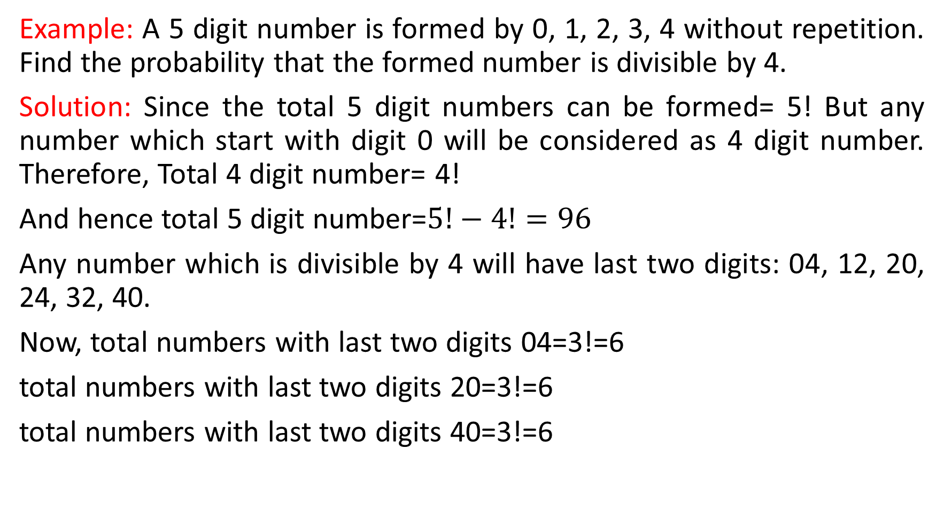
Example: A 5 digit number is formed by 0, 1, 2, 3, 4 without repetition. Find the probability that the formed number is divisible by 4.
Solution: Since the total 5 digit numbers can be formed= 5! But any number which start with digit 0 will be considered as 4 digit number. Therefore, Total 4 digit number= 4!
And hence total 5 digit number=$5!−4!=96$
Any number which is divisible by 4 will have last two digits: 04, 12, 20, 24, 32, 40.
Now, total numbers with last two digits 04=3!=6
total numbers with last two digits 20=3!=6
total numbers with last two digits 40=3!=6

Slide 16
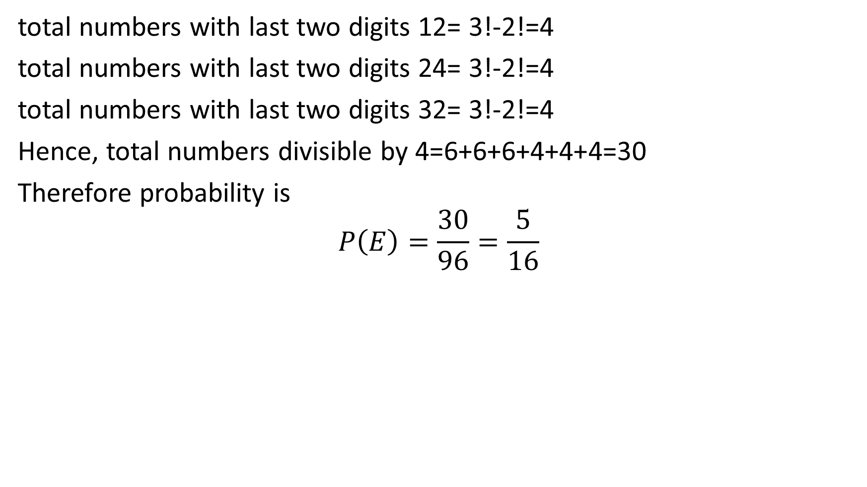
total numbers with last two digits 12= 3!-2!=4
total numbers with last two digits 24= 3!-2!=4
total numbers with last two digits 32= 3!-2!=4
Hence, total numbers divisible by 4=6+6+6+4+4+4=30
Therefore probability is
$$P\left(E\right)=\frac{30}{96}=\frac{5}{16}$$

Slide 17
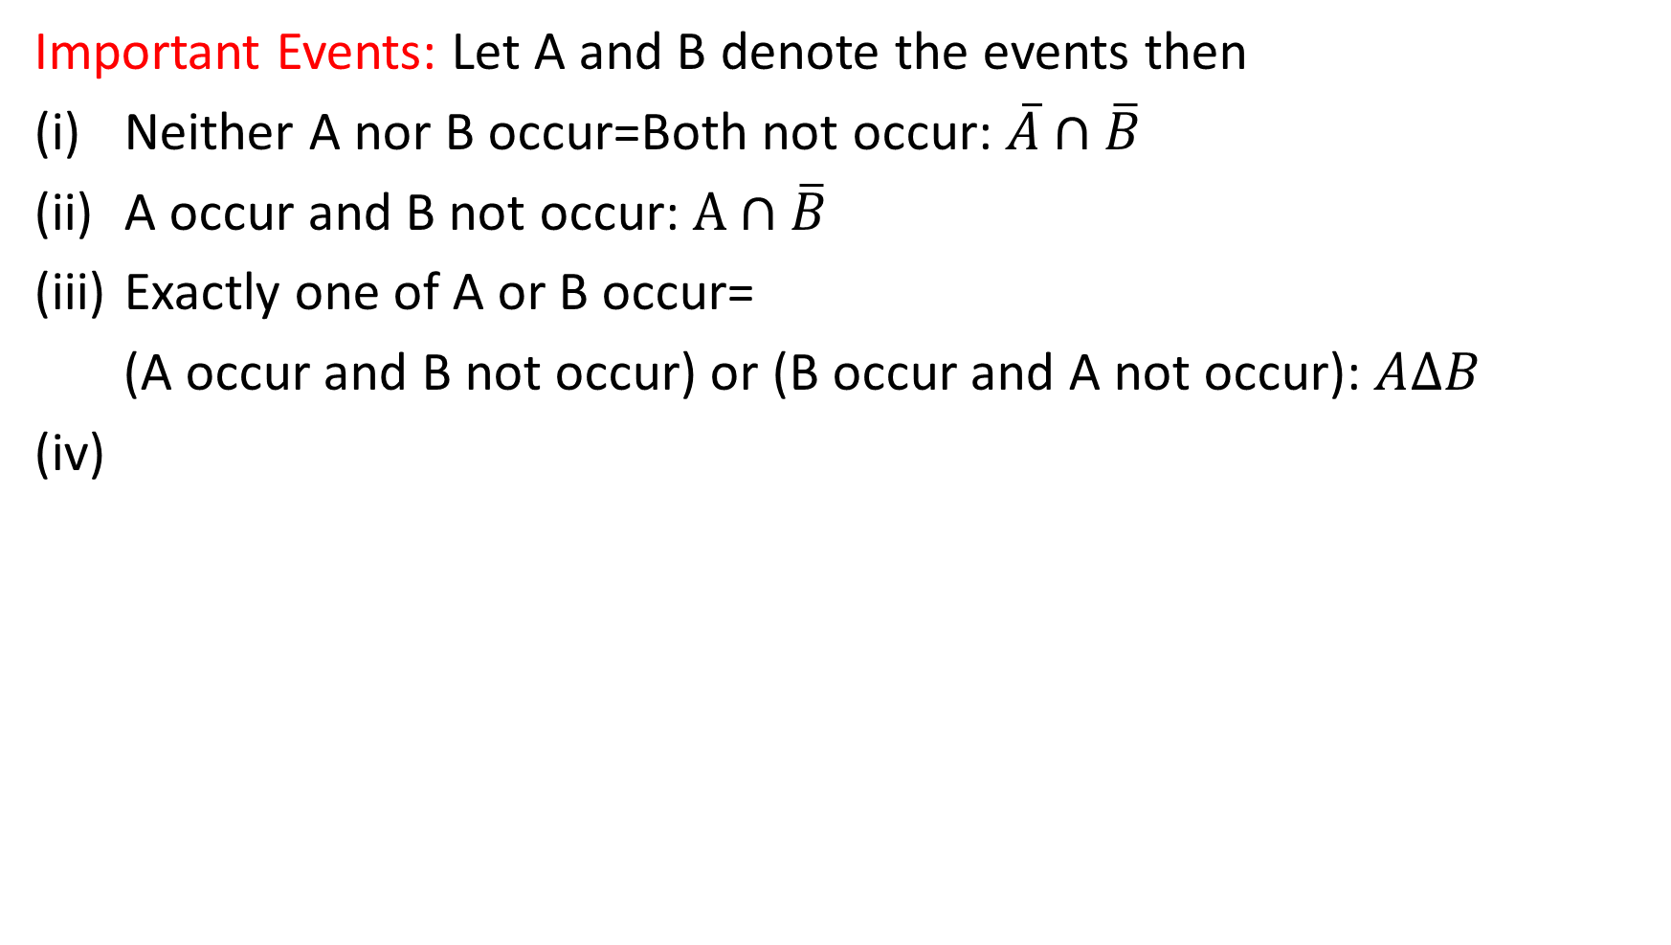
Important Events: Let A and B denote the events then
Neither A nor B occur=Both not occur: $\overline{A}∩\overline{B}$
A occur and B not occur: $A∩\overline{B}$
Exactly one of A or B occur=
(A occur and B not occur) or (B occur and A not occur): $A∆B$
(iv)

